Slide 1
Lucky Charms Project
Use your CodeX to code and play a game of chance with four-leaf clovers

Slide 2
St. Patrick’s Day
St. Patrick’s Day is March 17, and it is known for its lucky 4-leaf clovers.
Do you have the luck of the Irish?
Grab your CodeX device…
Let’s write some code …
and play a lucky charms game of chance!

Slide 3

Getting Started
You will use CodeSpace for this project.
Go to make.firialabs.com
Log in (use your account)
Go to the Sandbox
Icon on the right side bar, near the bottom

Slide 4
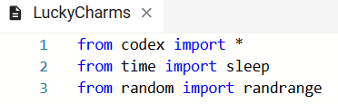
Getting Started
In the text editor:
Start a new file: LuckyCharms
Import the codex library, sleep and randrange

Slide 5
Lucky Charms Project
Part 1 – starter code

Slide 6
Step 1
Open the starter code provided by the teacher: LuckyCharms_starter
Copy the code from the file, and paste it into your new file.
Run the code. You should see:
A three-leaf clover
A 2-second delay
A four-leaf clover

Slide 7
Step 2
Adjust the sizes and positions of the circles to get the clovers just the way you want.
Skip to slide 17

Slide 8
Lucky Charms Project
Part 1 – draw your own clovers

Slide 9
Step 1
Define a function for the three-leaf clover.
This clover will have three circles for the leaves.
Two on the bottom and one in the middle on top.
Use display.fill_circle(x, y, radius, color)
The clover needs a rectangle for the stem.
Use display.fill_rect(x, y, width, length, color)

Slide 10
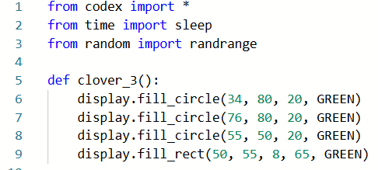
Step 1
Your code could look like this:

Slide 11
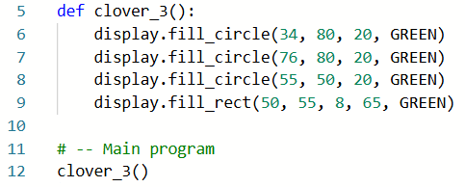
Step 1
Call the function in the main program:

Slide 12
Step 1
Test your code and make any changes until you get the clover just the way you want it.
You may want to add more clovers, so don’t make it too big.

Slide 13
Step 2
Define a function for the four-leaf clover.
This clover will have four circles for the leaves.
Two on top and two on the bottom.
Use display.fill_circle(x, y, radius, color)
The clover needs a rectangle for the stem.
Use display.fill_rect(x, y, width, length, color)

Slide 14
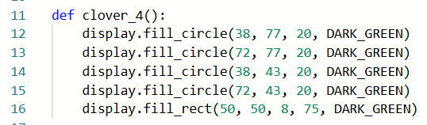
Step 2
Your code could look like this:

Slide 15
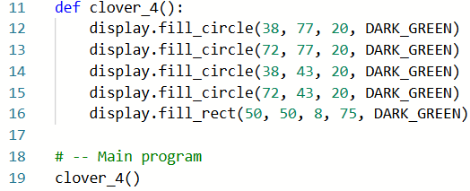
Step 2
Call the function in the main program:

Slide 16
Step 2
Test your code and make any changes until you get the clover just the way you want it.
You may want to add more clovers, so don’t make it too big.

Slide 17
Lucky Charms Project
Part 2 – start the game

Slide 18
Step 3
You decide the probability of displaying a 3-leaf or a 4-leaf clover.
Probability | Chance of displaying 4-leaf clover | Chance of displaying 3-leaf clover
80% | 4 out of 5 times | 1 out of 5 times
75% | 3 out of 4 times | 1 out of 4 times
50% | 1 out of 2 times | 1 out of 2 times
33% | 1 out of 3 times | 2 out of 3 times
25% | 1 out of 4 times | 3 out of 4 times
20% | 1 out of 5 times | 4 out of 5 times

Slide 19
Step 3
The code will generate a random number to use with the probability.
Generate a number between 0 and 99.
Compare the random number to the probability to get a Boolean value.
The higher the probability, the easier it is to win.
Use a function for this task, which returns True or False.

Slide 20
Step 3
Define the function.
Use two parameters: num and prob
num is the random number generated (0-99)
prob is the probability you choose for selecting a 3-leaf or 4-leaf clover
The prob will be an integer, not a percent!

Slide 21
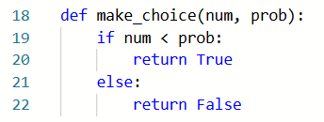
Step 3
Your code could look like this:

Slide 22
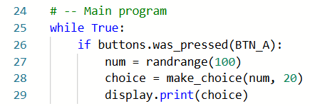
Step 3
Test your code by calling it in the main program:
Remember: the higher the probability, the easier it is to win. A low probability makes it harder to win.

Slide 23
Step 3
Test your code.
You should see “True” or “False” displayed on the screen every time you press BTN-A.

Slide 24
Step 4
Use the Boolean choice to display a clover.
If choice is True, display the 4-leaf clover.
Else, display the 3-leaf clover.
Define a function for this, with one parameter (choice)

Slide 25
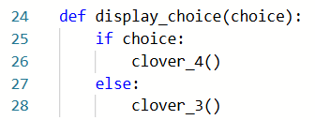
Step 4
Your code could look like this:

Slide 26
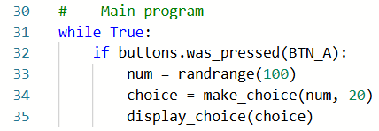
Step 4
Call the function in the main program:

Slide 27
Step 4
Test your code.
You should see a clover appear each time you press BTN-A.
But wait…!
There is a bug!

Slide 28
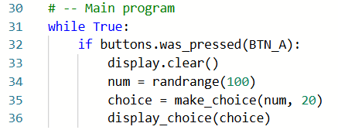
Step 5
The clovers just display on top of each other.
Clear the screen before each new clover is displayed.

Slide 29
Step 5
Test your code again.
Change the probability a few times and see what happens.

Slide 30
Step 6
Make the pixels flash when you get a 4-leaf clover!
Define a function for this.
You can make the pixels flash any way you want, and for as long as you want.
An example of the function is on the next slide.

Slide 31
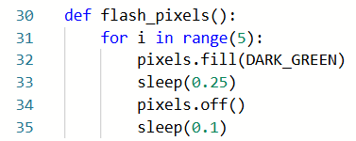
Step 6
Your code could look similar to this:

Slide 32
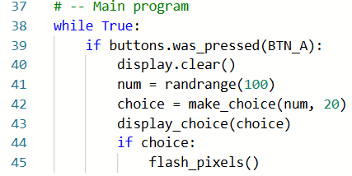
Step 6
Call the function in the main program when choice is True.

Slide 33
Step 6
Test your code again.
Change the probability to the amount you want for your game.
The pixels should flash each time the 4-leaf clover appears.

Slide 34
Step 7
Add a counter to tell you how many tries it took to get a 4-leaf clover.
Initialize the count variable to 0.
Every time BTN-A is pressed, increment count.
Display count when a 4-leaf clover is displayed.
Then reset count to 0.

Slide 35
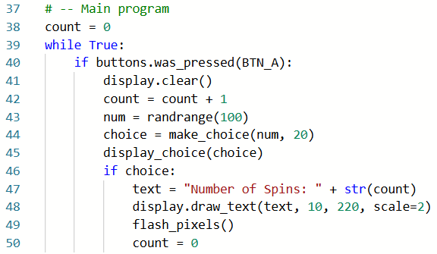
Step 7
This code is in the Main Program.

Slide 36
Step 7
Test your code again.
The number of “spins” is displayed and the pixels flash each time the 4-leaf clover appears.
You can adjust the probability to make the game easier or harder.

Slide 37
Lucky Charms Project
Part 3 – adding clovers

Slide 38
Step 8
The basic game is complete, but it only has one clover at a time.
Make the game more challenging by adding more clovers!

Slide 39
Step 8
First, add parameters to the clover functions.
Use x and y for the clover location.
Use the parameters in the function.
For each x location, add x+
For each y location, add y+

Slide 40
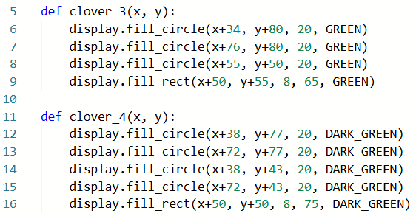
Step 8
Your code should look like this:

Slide 41
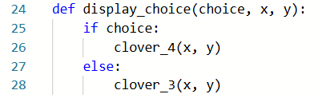
Step 8
Use arguments in the display_choice() function.

Slide 42
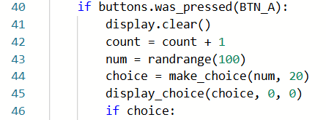
Step 8
Use the arguments 0, 0 when calling the function in the main program.
The clovers are in the same location!

Slide 43
Step 9
Now make more clovers by changing the arguments, which changes the location.
Use some math to think about the location.
For a clover to the right of the first one, you only need to adjust the x variable.
About 110 pixels is a good place to start.

Slide 44
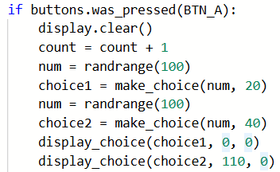
Step 9
Generate another random number.
Get a second choice.
Call display_choice() again, with a different value for x.

Slide 45
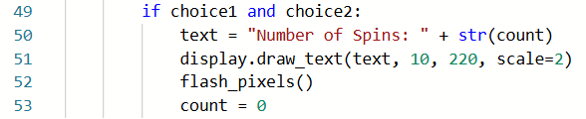
Step 9
To win, you must have two 4-leaf clovers.
Modify the condition for winning.
Test your code!

Slide 46
Step 10
Two clovers are great, so how about three!
Repeat the process a third time.
Generate another random number
Get a third choice.
Call display_choice() again, with a different value for x and for y.
You can start with x=55 and y=90

Slide 47
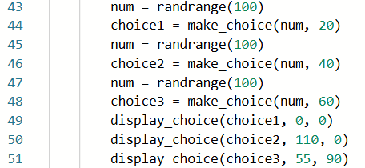
Step 10
You can use the same probability for the clovers, or have a different probability for each one.

Slide 48
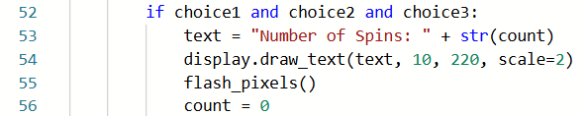
Step 10
To win you must have three 4-leaf clovers.
Modify the condition for winning.
Test your code!
Adjust any probability if needed.

Slide 49
Lucky Charms Project
Part 4 – extras

Slide 50
Step 11
Your lucky charms game is complete, but not very user friendly.
Add an introduction so the person playing the game knows what to do.
You can customize the introduction using your own creativity.
An example of an introduction is on the next slide.

Slide 51
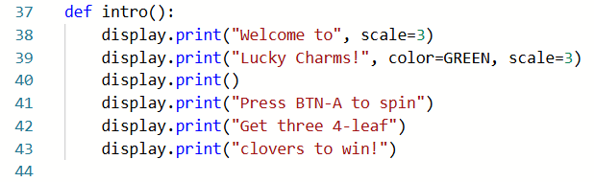
Step 11

Slide 52
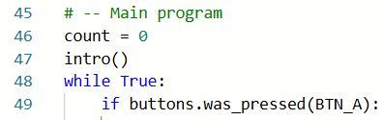
Step 11
Don’t forget to call the function in the main program.
Test your program.

Slide 53
Step 12
An ending would be nice as well.
Your program can keep track of the lowest number of spins needed to “win” and display it as part of the ending.

Slide 54
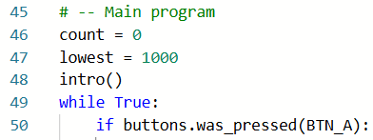
Step 12
First, write code to keep track of the lowest number of spins.
Define a lowest variable.
Assign it a ridiculously high number.

Slide 55
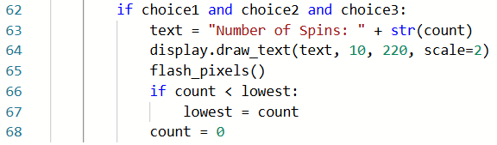
Step 12
Use another if statement to compare the current count with the lowest variable.

Slide 56
Step 12
Display the lowest number of spins in an ending message.
You can customize the ending using your own creativity.
An example of an ending is on the next slide.

Slide 57
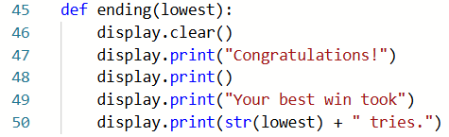
Step 12

Slide 58

Step 12
Don’t forget to call the function in the main program.
Use a button press.
Test your program.

Slide 59
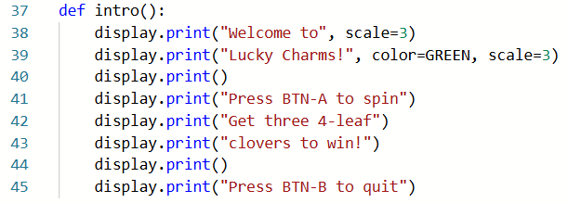
Step 12
You may want to add this option to the introduction.

Slide 60

Step 12
Give your program a final run and make any changes needed so the game works just the way you want.

Slide 61
Lucky Charms Project
Extensions
Add even more elements to your game.

Slide 62
Extensions
Keep track of the highest number of spins needed to “win” and display in the ending.
Use a random number for the probability.
Add a fourth clover to the game.
Add levels to the game. For example, press U for easy and D for hard. Then adjust the probabilities for the levels.
Add a third image to the game and assign another probability of how often it shows up. If it shows up all three times, you lose – game over!

